Slide 1
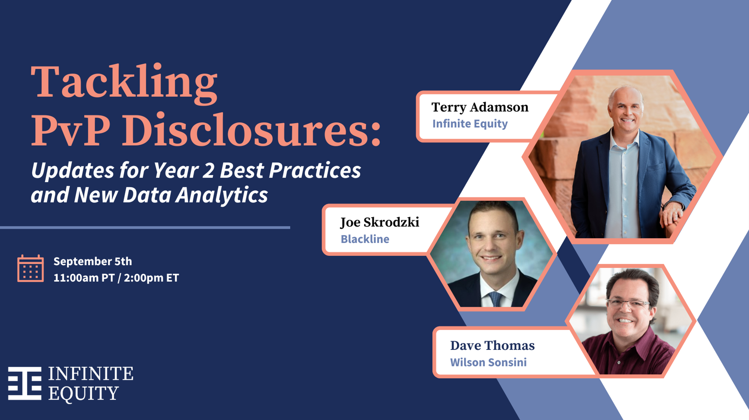
Tackling PvP Disclosures:
Updates for Year 2 Best Practices and New Data Analytics
September 5, 2024

Slide 2
Brief Background Slide
For calendar year companies, beginning with the 2023 proxy statement, most public companies are required to include a section with Pay versus Performance disclosure for the company’s named executive officers (NEOs) following a set of standardized rules
  Exceptions for: Emerging growth companies, foreign private issuers, registered investment companies
Year 1 required 3 lookback years, Year 2 required 4 lookback years, Year 3 (2025) and beyond will require 5 lookback years
Rules require detail on the Principal Executive Officer and, separately, averaged detail for all other NEOs
You are also required to show graphs and/or narrative explanations of the relationship between the pay information and performance information
Pay Information | Performance Information
Summary Compensation Table | Company TSR
Compensation Actually Paid (editorial note: that this is not compensation that gets actually paid, nor is it realized pay or realizable pay) | Peer TSR
 | Net Income
 | Company Selected Performance Measure

Slide 3
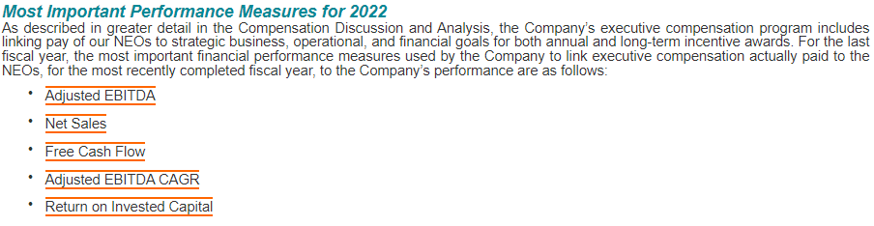
PvP Disclosures | Company Selected Measures

Slide 4
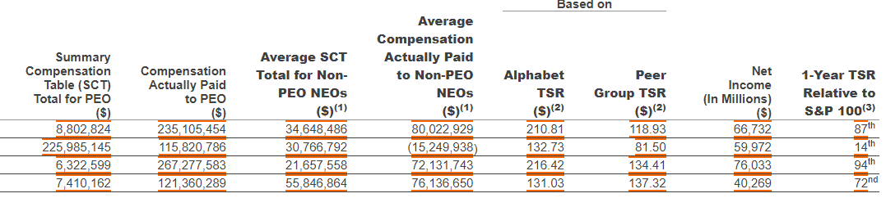

Pay Vs. Performance - Main Table Example
Company Selected Measure
4

Slide 5

Pay Vs. Performance - Main Table Example
Company Selected Measure
How can Compensation Actually Paid (CAP) be Negative?
5

Slide 6
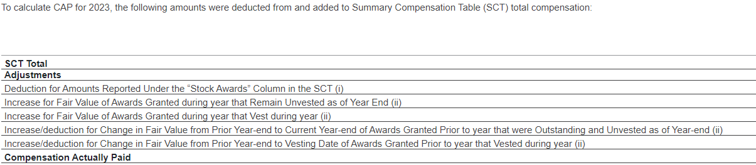
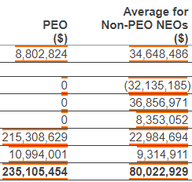
PvP Disclosures | Reconciliation Example
To get to Compensation Actually Paid, you add and subtract from the Summary Compensation Table Total Compensation Figure
Note that the reconciliation is only required for the most recent year (2023 in this case). It is not necessary to show the reconciliation for prior years.
This is an example of a “vertical” reconciliation. Some others have chosen to use a similar chart but in a “horizontal format”

Slide 7

Pay Vs. Performance - Main Table Example
Company Selected Measure
How can Compensation Actually Paid (CAP) be Negative?
Do investors care about this?
7

Slide 8

Pay Vs. Performance - Main Table Example
Company Selected Measure
What Does This Mean?
At the end of 2023, the company was worth 210% of what it was worth at the end of 2019
How can Compensation Actually Paid (CAP) be Negative?
CAP is for 1-Year, but TSR is over multiple years. There is a disconnect!
Do investors care about this?
8

Slide 9

Pay Vs. Performance - Main Table Example
Company Selected Measure
What Does This Mean?
At the end of 2023, the company was worth 210% of what it was worth at the end of 2019
How can Compensation Actually Paid (CAP) be Negative?
CAP is for 1-Year, but TSR is over multiple years. There is a disconnect!
Do investors care about this?
What can analysis be done from the data?
9

Slide 10
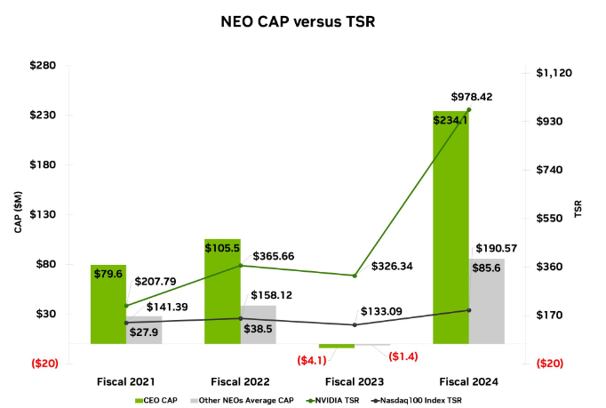
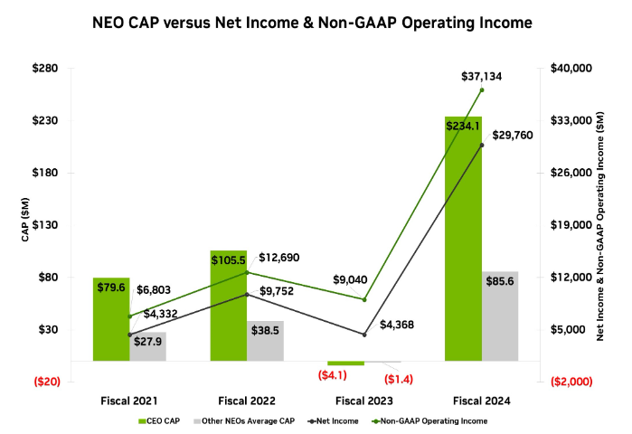
PvP Disclosures | Graphical Relationship Example

Slide 11
Pay Vs. Performance - What’s “New”?
Updated Guidance | Topic
 | Retirement Eligibility (128.D.18) Option Valuation (128.D.21) Reconciliation of SCT to CAP
 | Industry Peer Group (as compared to Broad Index) Labeling Consistency Descriptive Relationships of CAP to Performance Measures
There have been 30 C&DIs issuing clarifications: Questions 128.D.1 – 128.D.30
There have been 31 Comment Letters from the SEC
11

Slide 12
C&DI Highlights – 128.D.18 – Retirement Eligibility
Considerations for Retirement Eligibility:
  On 9/27, initial C&DI seemed to indicate that if the award holder is Retirement Eligible, and that allows for continued vesting of equity (either in full or pro rata), there is no substantive service condition or risk of forfeiture
  However, on 11/14, a revised C&DI was released
(Revised) Question 128D.18 | Retirement Eligibility
Some stock and option awards allow for accelerated vesting if the holder of such awards becomes retirement eligible. If retirement eligibility was the sole vesting condition, would this condition be considered satisfied for purposes of the Item 402(v) of Regulation S-K disclosures and calculation of executive compensation actually paid in the year that the holder becomes retirement eligible?
Answer: Yes. However, if retirement eligibility is not the sole vesting condition, other substantive conditions must also be considered in determining when an award has vested. Such conditions would include, but not be limited to, a market condition as described in Question 128D.16 or a condition that results in vesting upon the earlier of the holder’s actual retirement or the satisfaction of the requisite service period. [November 21, 2023]
Infinite Equity Commentary: The ambiguous and conflicting language in the original and final C&DIs has not helped. We believe that either interpretation is appropriate (either continuing to remeasure until the actual vesting date, or remeasuring until the satisfaction of the requisite service period), as long as disclosed and footnoted appropriately.

Slide 13
C&DI Highlights – 128.D.21 – Stock Option Valuation
Considerations for Stock Option Valuation:
    The valuation must be ASC718 compliant
    2 approaches were deemed non-compliant:
      Elapsed Time approach – subtract the lapsed time from the initial valuation date to the current valuation date
      Simplified approach – midpoint of contractual term and vesting used as a safe harbor for grant date valuations
    Implies that any approach should consider the “in-the-moneyness” level
    Infinite Equity commentary: There are several recognized approaches that are scalable and could easily be applied by registrants. One such approach is IRS Revenue Procedure 2003-68 which provides safe harbor tables for option valuation based on the remaining contractual term and the in-the-moneyness level and are already used in the Proxy for estimation of 280G golden parachute liabilities. However, the tables have limited use for options that are well “in-the-money”.

Slide 14
PvP Table Choices | Key Findings
Companies have choices to select elements of the PvP disclosure - - for some choices there was a clear majority practice, while for others, practices were more mixed
Choices | Results
TSR comparator group: Peer group used for making executive pay decisions Peer group or published industry/line of business (LOB) index from annual report performance graph | Most (81%) used an industry / LOB index from annual report performance graph as their TSR comparator group
Company selected measure (CSM): Can use relative TSR Can use stock price if it’s an incentive plan metric Can’t use: Absolute TSR or net income because already in table Multiyear metric | CSMs varied among companies, even within the same industry sector but: Almost 30% of the S&P 500 sample selected earnings per share (EPS) Almost 30% of the Russell 3000 sample selected earnings before interest, taxes, depreciation and amortization (EBITDA) In four of 11 industry sectors, more than half of companies selected the same CSM: In Financials, 58% used a return metric; in Materials, 55% used EBITDA; in Real Estate, 75% used EPS; and in Utilities, 63% used EPS
List of three to seven metrics How many? Whether to include non-financial metrics? | Majority chose to include three to five measures in their tabular list: Over 75% of the sample did not include any nonfinancial measures Revenue and EPS were the most common measures — each used by over 40% of the sample
Description of pay vs. performance relationship: Graph/chart, narrative or both | Approximately 90% used at least one graph/chart to describe the relationship Most did not include robust narratives
Notes:
Liz

Slide 15
Blackline – Case Study
Unique Disclosure requiring Engagement with Internal and External Stakeholders
  Internal Stakeholders
    Investor Relations – What is the appropriate Peer Group to use (consistent with Performance Graph?)
    Accounting - Are re-valuations ASC718 compliant?
    Legal – Overall responsibility for proxy statement
    Human Resources – Who are the Named Executive Officers and the Summary Compensation Table amounts
    Compensation Committee – Overall consultation regarding choices made
  External Stakeholders
    External Counsel
    Equity Valuation Consultant
    Compensation Consultant
15

Slide 16
Blackline – Process / Timeline
  Compile outstanding equity data (anytime after March of fiscal year as to include current year grants)
  Compose list of potential Named Executive Officers for fiscal year
  Initial estimates for Compensation Actually Paid reviewed in Q3 of Fiscal Year
  Final estimates done on January 2nd
  Final calculations and disclosures completed upon completion of Summary Compensation Table
  Drafting of Proxy in January
16

Slide 17
Pay Vs. Performance - Main Table Example
Company Selected Measure
What can analysis be done from the data?
How can Compensation Actually Paid (CAP) be Negative?
CAP is for 1-Year, but TSR is over multiple years. There is a disconnect!
Do investors care about this?
17

Slide 18

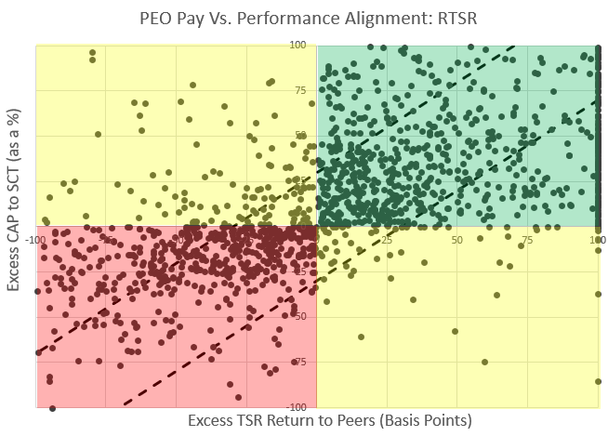
Measuring PvP Alignment | The Russell 3000
Start with Russell 3000, eliminate EGCs , SRCs, and FPIs – leaving 2,200 companies.
Distribution of Quadrants / Zones
 | Zone A | Zone B | Zone C | Total
Quadrant 1 | 464 | 133 | N/A | 597 (27.1%)
Quadrant 2 | 227 | 453 | 187 | 867 (39.4%)
Quadrant 3 | 225 | 325 | 31 | 581 (26.4%)
Quadrant 4 | N/A | 62 | 963 | 155 (7.0%)
Total | 916 | 1251 | 311 | 2,200 (100%)
Fact 1
TSR > Peers (Quadrants 2+4)
only 46% of time
Fact 2
CAP > SCT
(Quadrants 1+2)
67% of time
18

Slide 19
PvP Analysis – What are Sharing Ratios?
What is the relationship between excess Compensation Actually Paid, as compared to the increase in TSR (or market capitalization)?
Sharing Ratio $=\frac{Excess CAP}{Excess Market Cap}= \frac{∑CAP − ∑SCT}{Market Cap2019YE x (TSR2023 −Peer TSR2023) }$
For every $1B of excess Market Cap, then $600K was delivered to the CEO
4 Year Total
$248.5M
$739.6M
Sharing Ratio $=\frac{(\$739.6M −\$248.5M\text{)}}{\$920B x (210.81−118.93)}= \frac{\$491M}{\$845B}=0.06\%$
Starting Market Cap
Company TSR minus Peer TSR
Would not have been created at Peer TSR
19

Slide 20
Sharing Ratios | The Russell 3000
Based on the 2,200 companies observed, 867 were in Quadrant 2, and 581 were in Quadrant 3.
Category of | Total | Quadrant 1 | Quadrant 2 |  | Quadrant 3 |  | Quadrant 4
Market Capitalization | # | # | # | Median Ratio | # | Median Ratio | #
Micro Cap (<$300M) | 206 | 94 | 73 | 1.30% | 16 | -3.45% | 23
Small Cap (<$2B) | 771 | 195 | 283 | 1.23% | 232 | -0.63% | 61
Mid Cap (<$10B) | 737 | 170 | 292 | 0.76% | 222 | -0.35% | 53
Large Cap (<$200B) | 458 | 130 | 207 | 0.39% | 104 | -0.09% | 17
Mega Cap (>$200B) | 28 | 8 | 12 | 0.06% | 7 | -0.01% | 1
All | 2200 | 597 | 867 | 0.75% | 581 | -0.36% | 155
Observation #1
Sharing Ratios decrease as the Market Cap level increases
Observation #2
Success is rewarded more than underperformance is disincentivized (bigger slopes in Quadrant 2 than Quadrant 3)
20
Notes:
Terry

Slide 21
Peer Group Selected
We have summarized the Selection for Communications Services (GICS = “50”) and Utilities (GICS = “55”)
    Infinite Equity commentary: There is a wide range in the “Peer TSR” when comparing selections of companies within the same GICS code. This may be because there has never been formal thought in the selection of the Industry Index for the Performance Graph, or it could alternatively be because the company has an inappropriate GICS code.
    Going forward, we anticipate much further rigor being put into the selection of the Peer TSR (either using an Industry Index or a custom group of Performance Peers).
Notes:
Liz

Slide 22
Getting Ready for PvP Table Year 3
Action Items
Did you re-value stock options?
Does your company have retirement eligibility provisions?
Did your company recently IPO?
Reconsider your valuation methodologies if you subtracted elapsed time or used the simplified method to determine the expected life.
Consult with counsel on interpretation of C&DIs to determine to use the legal vest date or the retirement eligibility date.
Check the as of dates for your fair value and TSR calculations.
Does your company grant performance awards?
Did your company recently lose EGC status?
You are required to comply with the full rules but may file for transitional relief to report only 3 years.
Ensure market conditions are valued through the vesting date, and that performance conditions reflect performance assessments.
Does your company have a disconnect between Pay and Performance?
  Ensure that you are not disclosing (Quadrant 1/Zone A)
Notes:
Liz

Slide 23
Questions and Closing Thoughts
Terry Adamson, FGE, CEP
Partner
Infinite Equity
terry@infiniteequity.com
+1.215.908.4036
Dave Thomas
Partner
Wilson Sonsini
dthomas@wsgr.com
+1.650.849.3261
wsgr.com/davethomas
Joe Skrodzki
VP, Total Rewards & Analytics
Blackline, Inc.
joe.skrodzki@blackline.com
+1.443.538.9310
23

